Slide 1



Slide 2
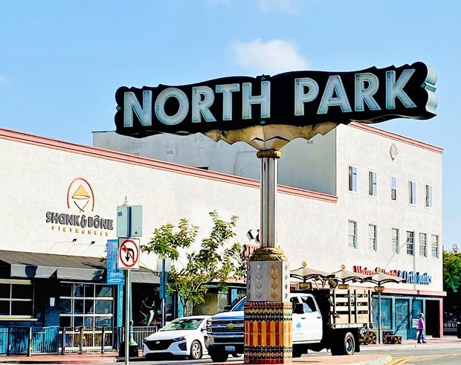
What is it?
Is a community app that helps to get “locals only” perks.
Starting soon in North Park.

Slide 3
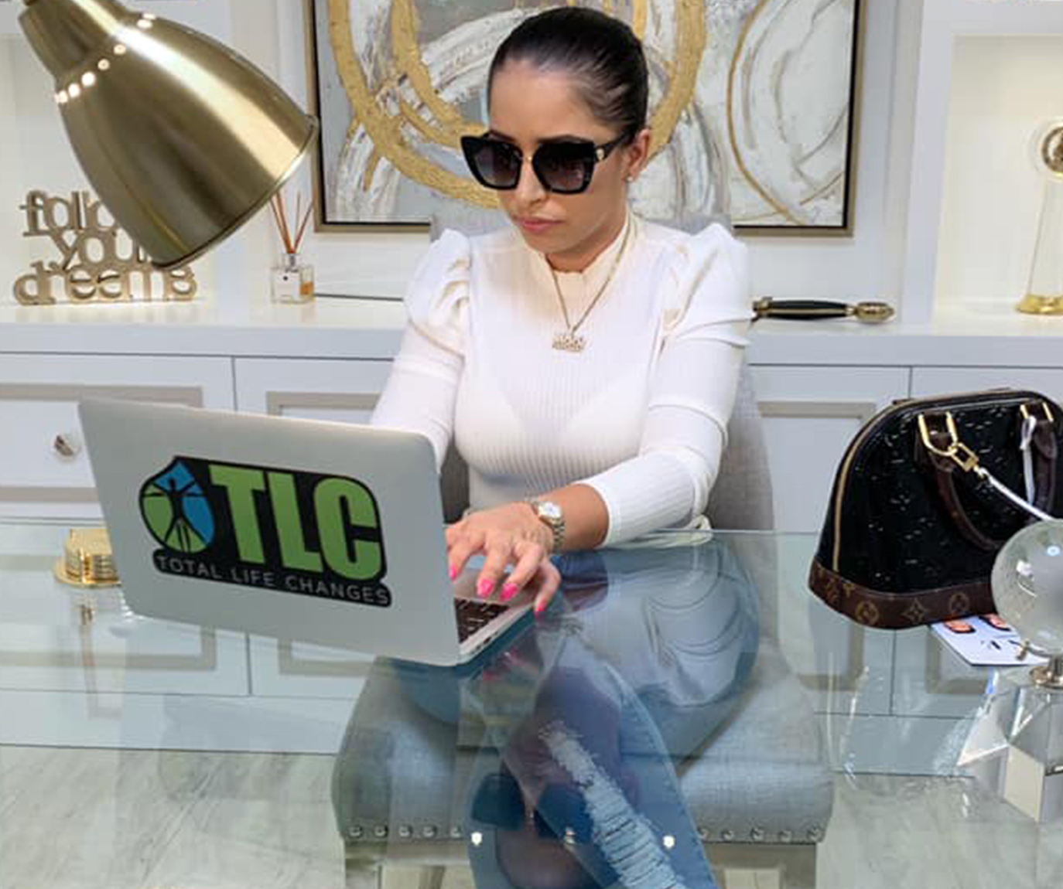
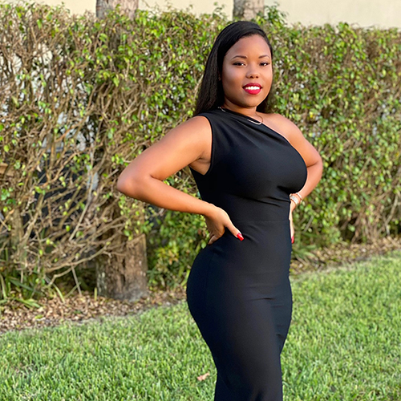
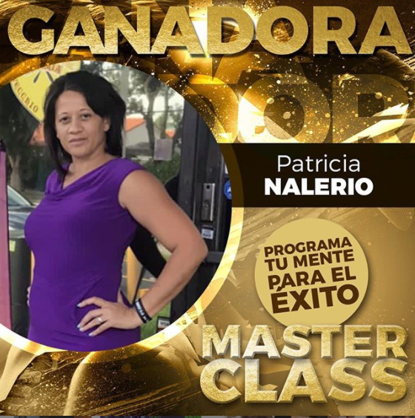
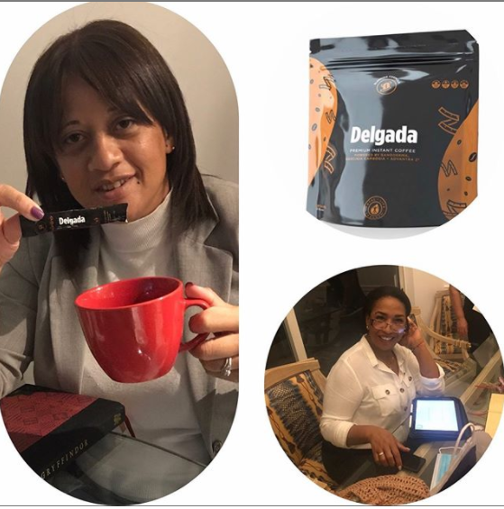
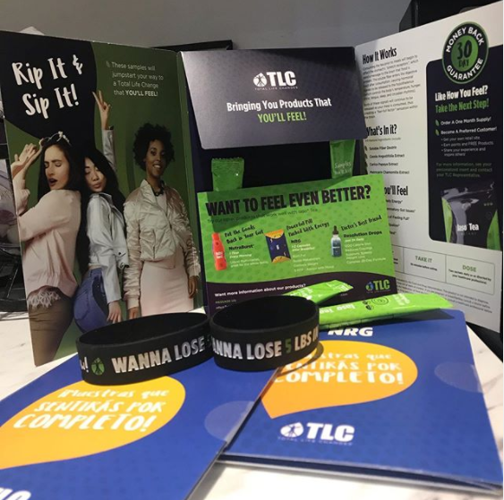
What I have done related to Walkabout
Webmaster for TLC products. 2020 (https://shop.totallifechanges.com/home?lang=en&sponsor=TotalLifeChanges360)
Created individual webpages for some of their associates and linked them to main order page (passing parameters).
Created original content (pictures and interviews) for each individual page.
Analytics and SEO. WordPress

Slide 4
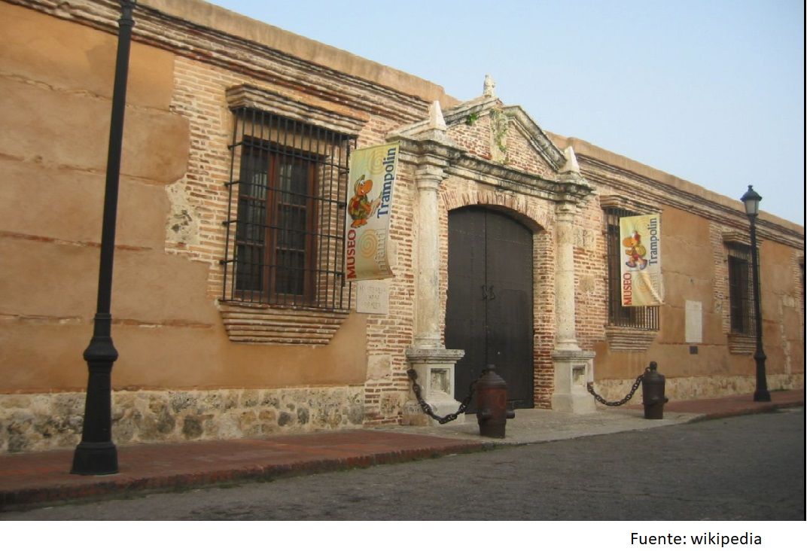
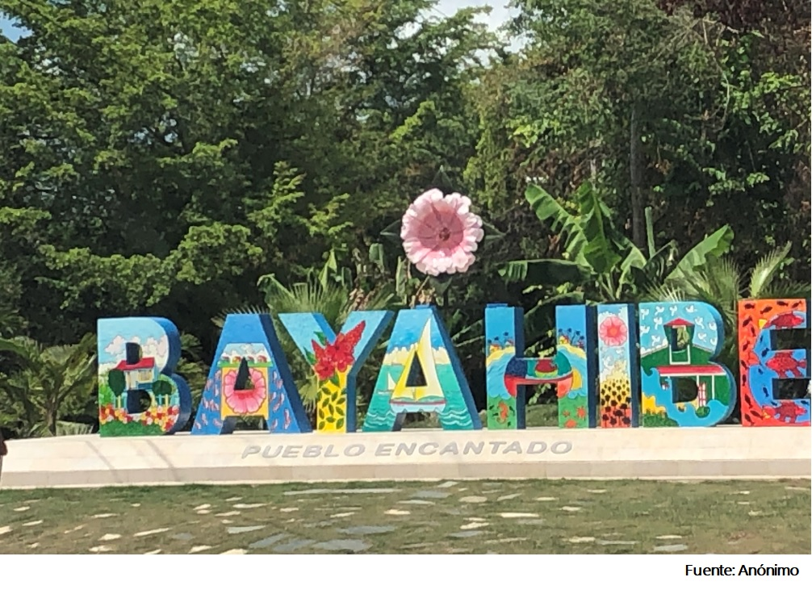
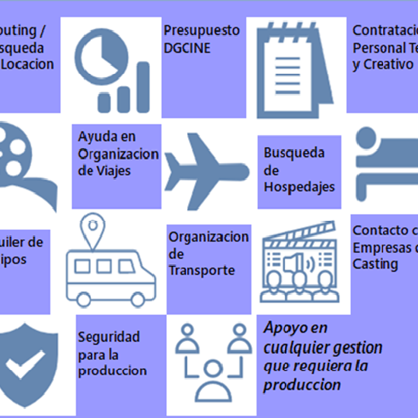
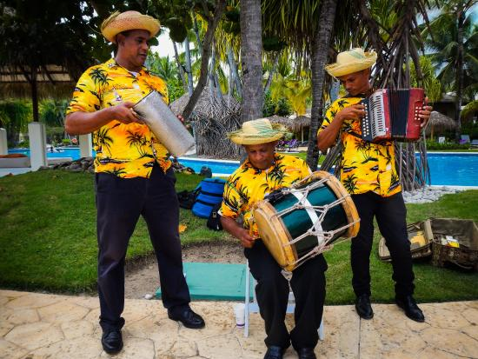
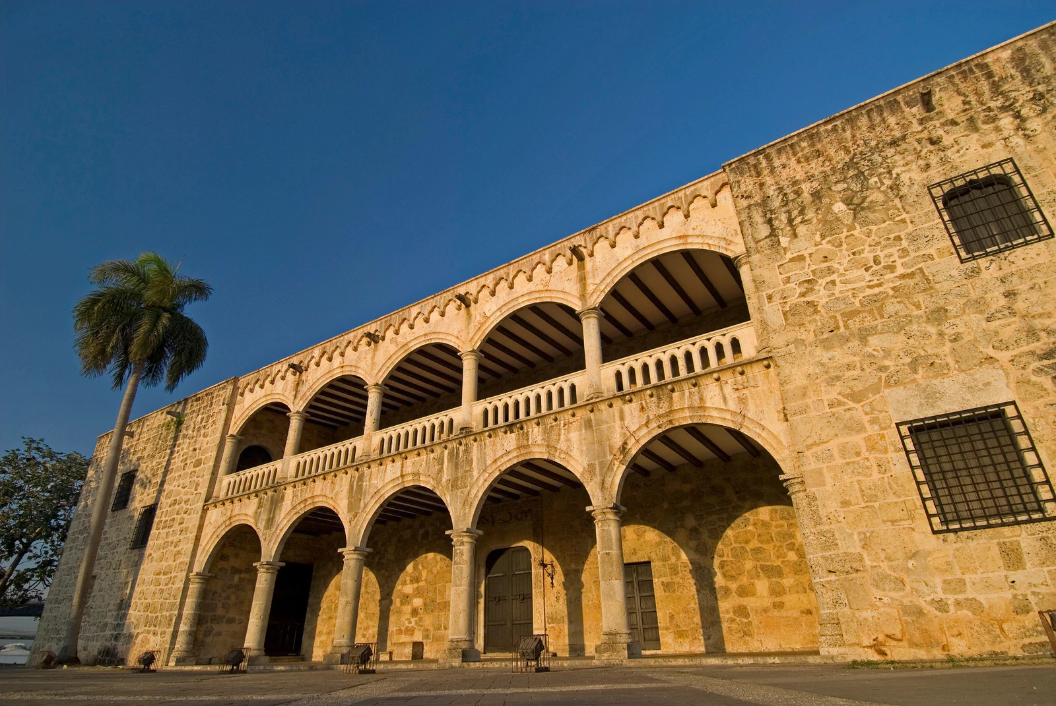
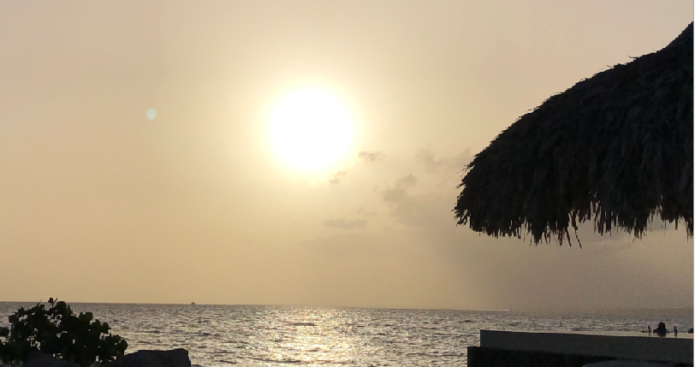
What I have done related to Walkabout – Cont’d
Company MTTH (2021)
Webmaster and content creator.
Google Analytics. WordPress

Slide 5
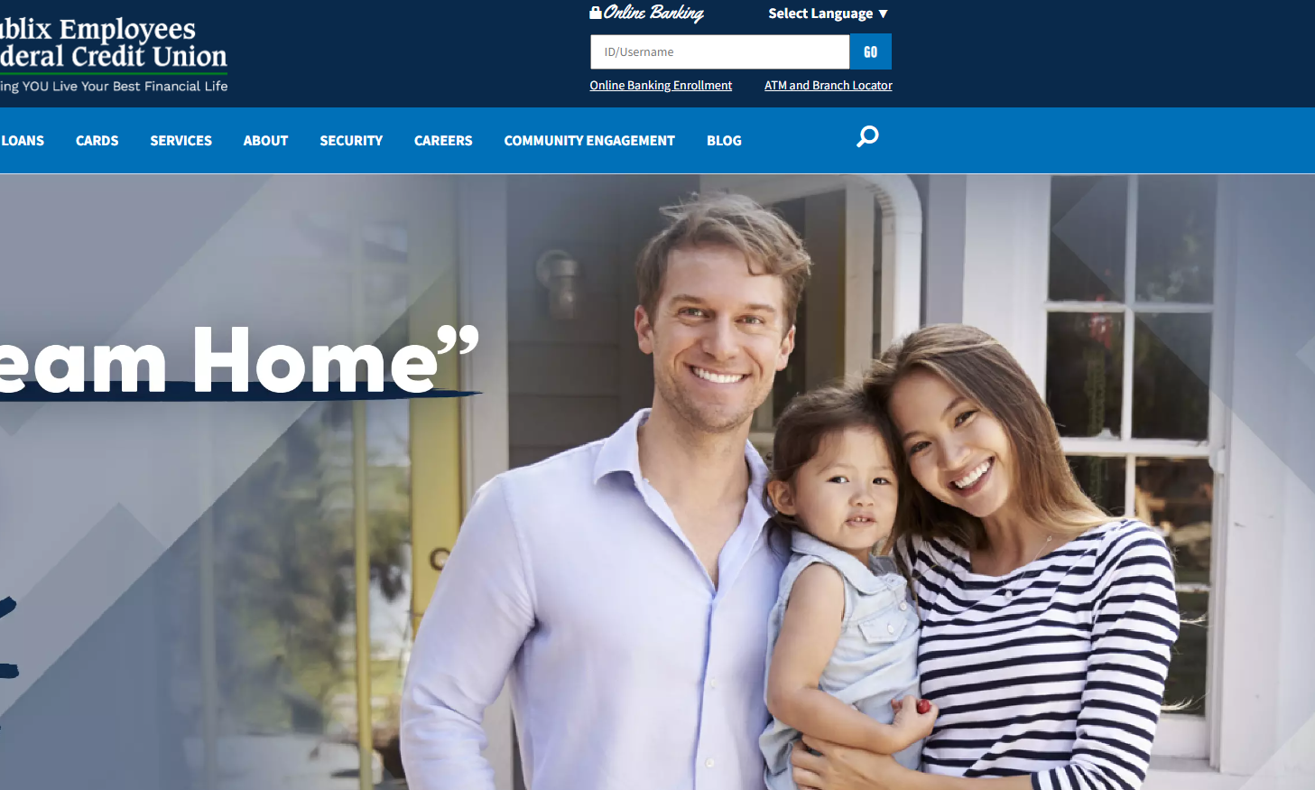
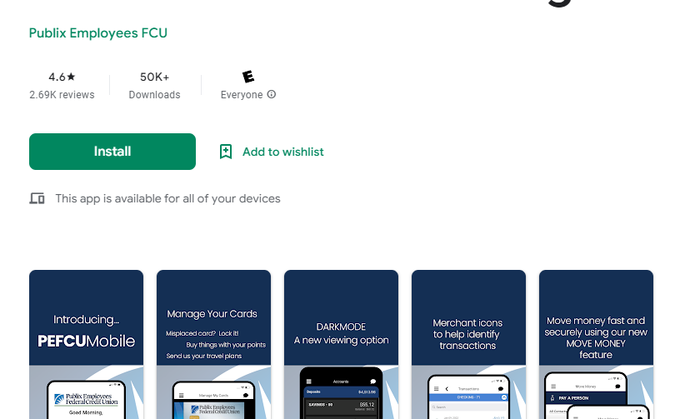
What I have done related to Walkabout – Cont’d
Publix Credit Union (PEFCU) database for their website and app. (2021)
Reports for Fraud department in SQL server and SSRS and Report Builder.
Marketing campaigns.
Research and development to obtain new members and lines of credit.
Reports for Loan department (SQL)
Google analytics and WordPress.

Slide 6





What I have done related to Walkabout – Cont’d
Past sales experience with the following companies:
FedEx (Several Sales Awards)
Carrier
DHL
LabCorp
Ingersoll Rand
Trane Supply (HVAC) Division of Ingersoll.

Slide 7
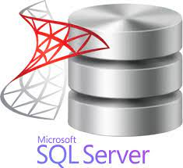









What I have done related to Programming
Reporting using SQL (SSMS and SSRS). Integrations in SSIS.
Power Bi reports such as Dashboards and
Reports using Tableau
File handling with Python
Visual Studio and Repos
Currently learning Scala

Slide 8
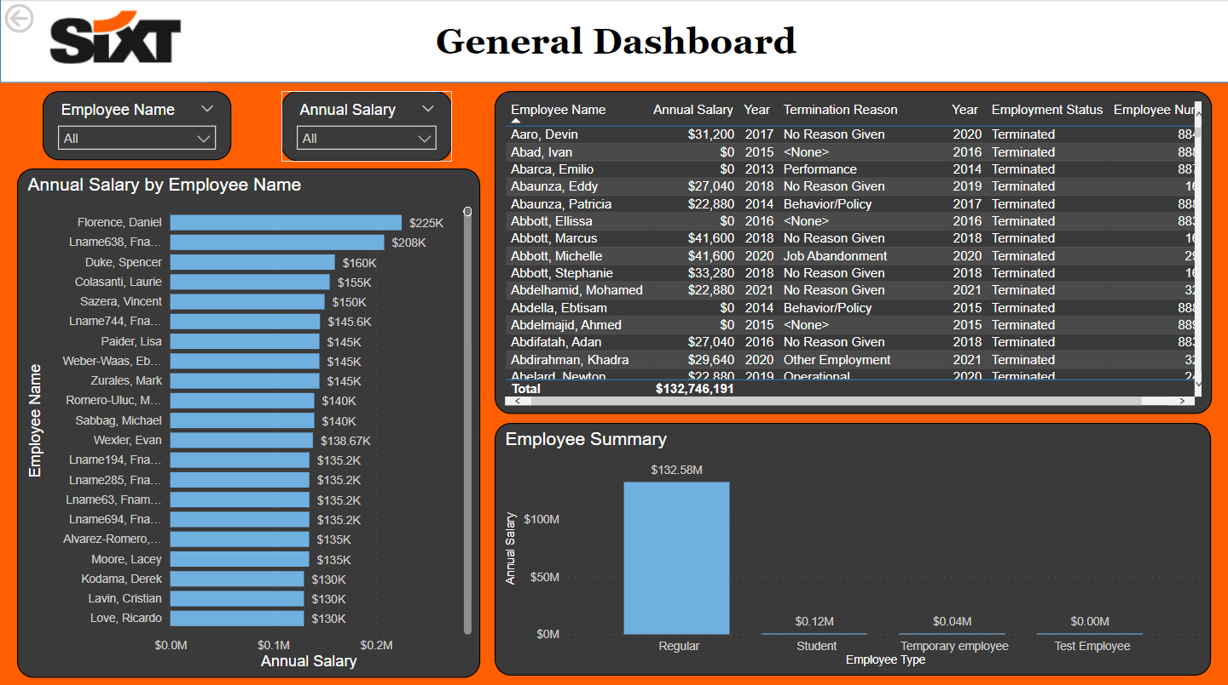
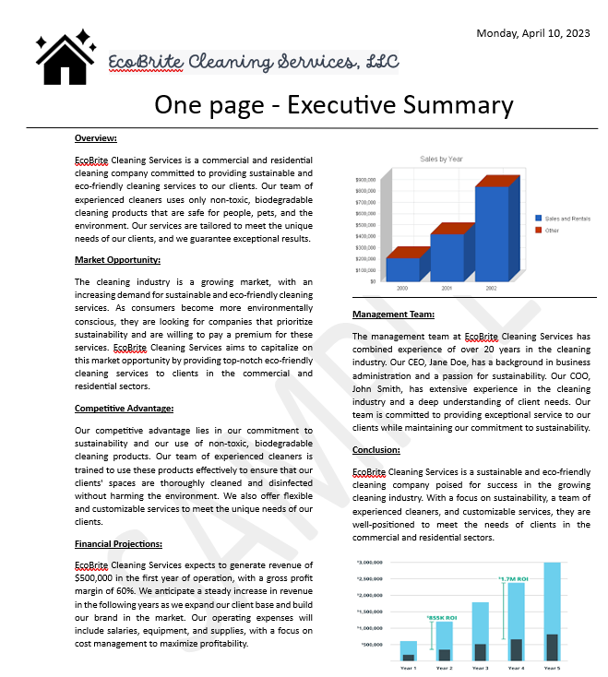
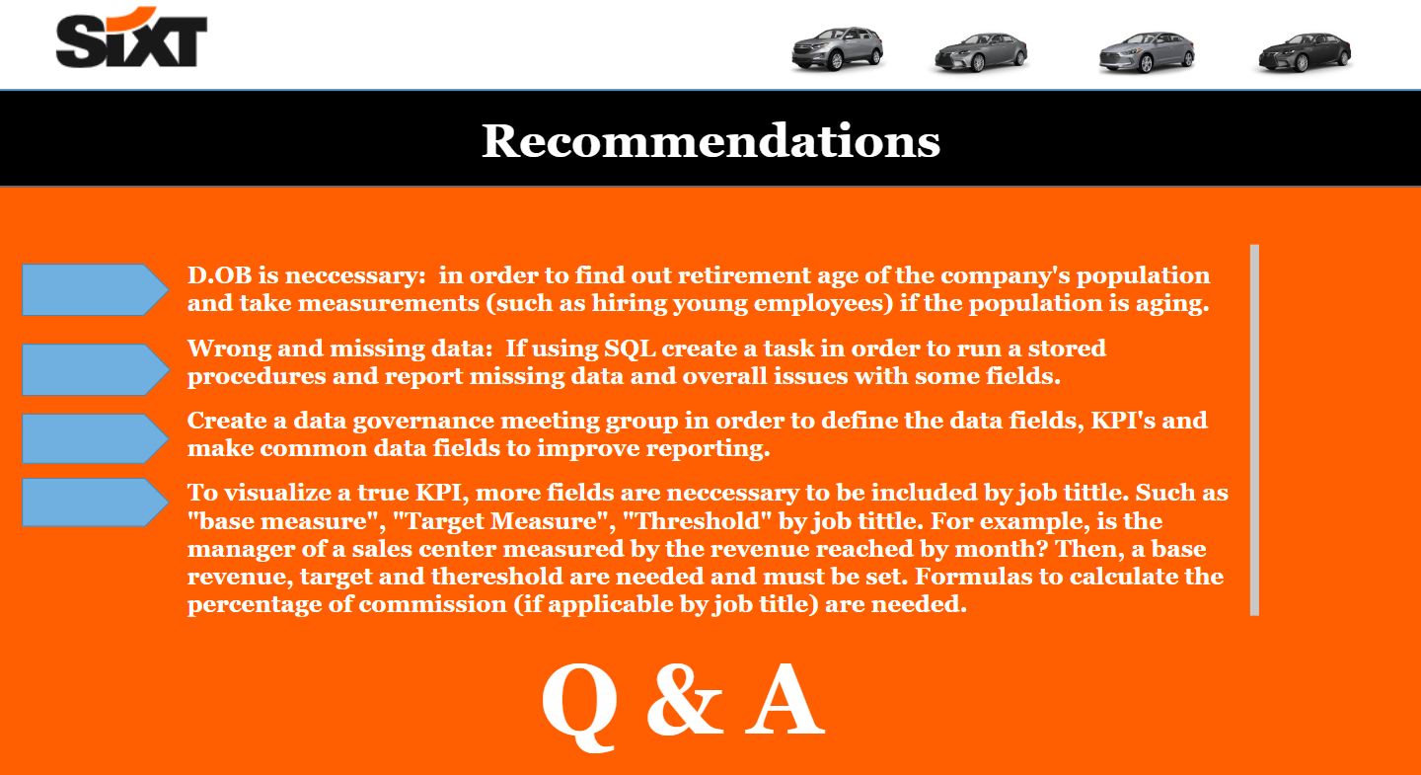
Dashboards –Executive Summaries
NOT Confidential information
NOT Confidential information

Slide 9
Comments
Amazing potential.
Unique in the market.
Needs more exclusive content. (No Pexels)
Recommendations
Change images to portray the local businesses.
Interview local businesses.
Get more followers from Social Media.
Use the “give back” feature to assist communities and increase awareness.

Slide 10

Q & A

